Slide 1
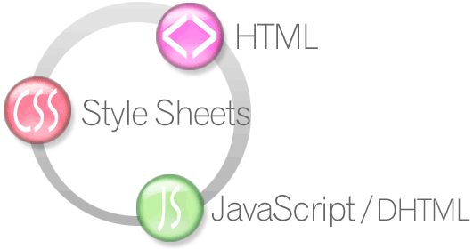

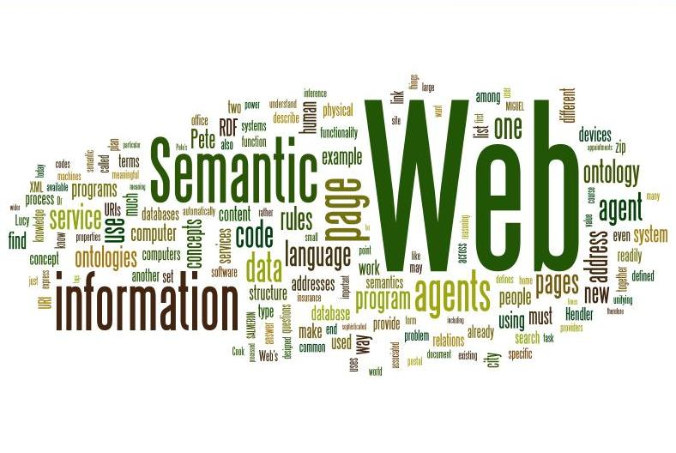
Semantic Web
How to Use HTML Elements Properly?
HTML5
Telerik Software Academy
http://academy.telerik.com

Slide 2

Table of Contents
Web Page
HTML, CSS and JavaScript
The Semantic HTML
HTML5 Semantic Tags
Other Semantics
Accessibility
Search Engine Optimization
Structured Data Markup

Slide 3

Web Page

Slide 4

The Elements of a Web Page
A Web page consists of:
HTML markup
CSS rules
JavaScript code
JS libraries
Images
Other resources
Fonts, audio, video, Flash, Silverlight, etc…

Slide 5

The Elements of a Web Page: HTML Markup
The HTML is used to define the content of a Web page
Not the layout
Not the decorations
HTML's role is to present the information in a meaningful manner
Like a paper document
Define headers, paragraphs, textboxes, etc…
Not define size, color and/or positioning

Slide 6
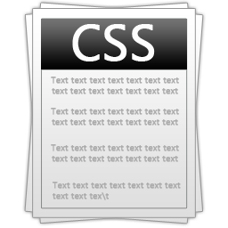
The Elements of a Web Page: CSS Rules
Cascading Style Sheets (CSS) is the way to make a Web page look pretty
Define styling rules
Fonts, colors, positioning, etc.
Define the layout of the elements
Define the presentation
The CSS files are attached to a web page and the browser applies these styles to elements

Slide 7

The Elements of a Web Page: JavaScript Code
JavaScript is the programming language for the Web
Makes the Web pages dynamic
Dynamically adding / removing HTML elements, applying styles, etc.
Modern JavaScript UI libraries provide UI components like dialog boxes, grids, tabs, etc.
Like CSS the JavaScript files are attached to a web page

Slide 8





The Elements of a Web Page: Other Resources
Other resources are needed for a Web page to run properly
Images, fonts (glyph icons), audio, video files
Flash / Silverlight / ActiveX objects

Slide 9
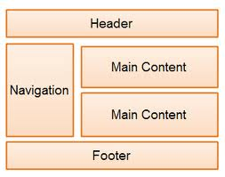
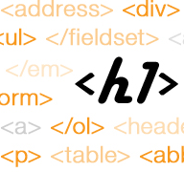
The Semantic HTML

Slide 10
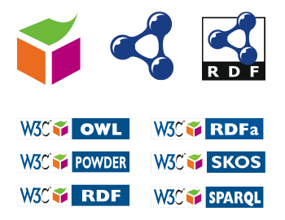
Semantic HTML
Semantic HTML is:
The use of HTML markup to reinforce the semantics of the information in Web pages
Make the content understandable for computers
Rather than merely to define its presentation
A kind of metadata about the HTML content
Semantic HTML is processed by regular Web browsers and other user agents
CSS is used to suggest its presentation to human users

Slide 11


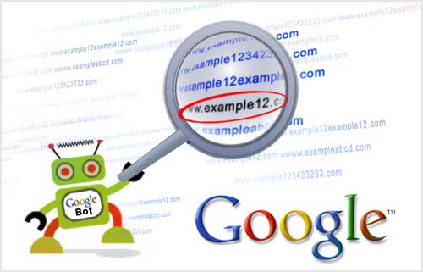
Why Use Semantic HTML?
Semantic HTML is:
Easier to read by developers, parsers, bots, machines, AIs
A way to show the search engines the correct content

Slide 12

How To Write Semantic HTML?
Just follow some guidelines when creating a Web site
Use HTML5 semantic tags
<header>, <nav>, <section>, <article>, <aside>, <footer>
Use Headings when you need to structure the content into sub-headings
In increasing order, staring with <h1>
Do not use empty tags
Like a clearing <div>

Slide 13

HTML5 Semantic Tags

Slide 14
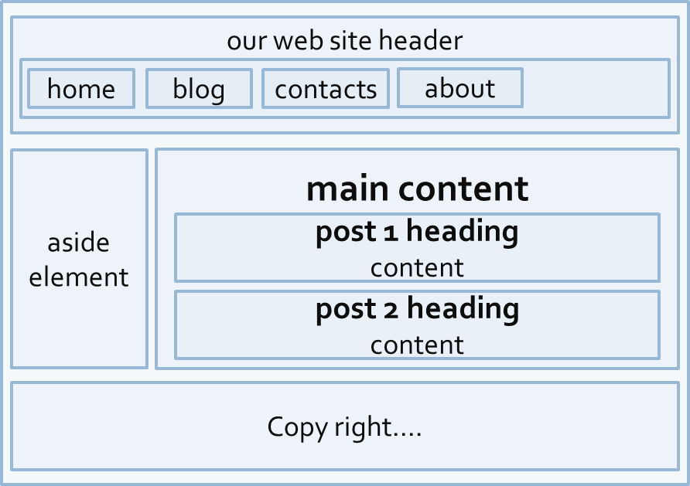
HTML5 Semantic Tags
HTML5 introduces semantic structure tags
Imagine the following site:
This is a common Web page structure
Used in 90% of the web sites

Slide 15
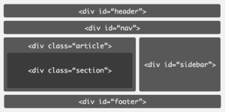
HTML5 Semantic Tags (2)
This can be created using all kind of HTML elements
<div>, <span>, even <p>
Browsers will render invalid / wrong / pseudo valid HTML
The correct way: use the HTML 5 semantic tags:
<header> … </header>
<nav> … </nav>
<main> … </main>
<article> … </article>
<section> … </section>
<aside> … </aside>
<footer> … </footer>

Slide 16
HTML5 Structure Tags
<main>
Specifies the main content of a document (info)
There must not be more than one <main> element in a document
<header>
Site header or section header or article header
Could include navigation (<nav>)
<footer>
Site footer (sometime can be a section footer)
Providing author, copyright data, etc.

Slide 17
HTML5 Structure Tags (2)
<nav>
Defines a set of navigation links.
E.g. site navigation (usually in the header)
<aside>
Content slightly related to primary content
E.g. sidebar (usually on the left or on the right)
<section>
Grouping of content usually with a heading, similar to chapters
Site section (e.g. news, comments, links, …)

Slide 18
HTML5 Content Tags
<article>
Independent content such as blog post or an article (e.g. news item)
<details> + <summary>
Specifies additional details that the user can view or hide on demand (accordion-like widget)
<time>
Specifies date / time (for a post / article / news)
<mark>
Defines marked/highlighted text

Slide 19
HTML5 Content Tags (2)
<figure>
Grouping stand-alone content (video or image)
Figure (a figure, e.g. inside an article)
<figcaption>
A caption of a figure (inside the <figure> tag)
<video> (info)
Video element (uses the built-in player)
<audio> (info)
A standard for playing audio files (built-in player)

Slide 20
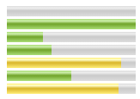

HTML5 Content Tags (3)
<dialog>
Defines a dialog box or window
<meter> / <progress>
Defines a scalar measurement within a known range (a gauge) or task progress
<output>
Defines the result of a calculation
<wbr>
Defines a possible line-break
More info

Slide 21
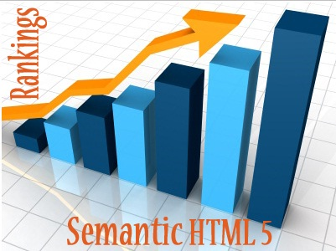
Other Semantics
Headings, ems, strongs

Slide 22
Other Semantics
Headings
Always use headings (<h1> – <h6>) when you need a heading or title
Like in a MS Word document
Google uses it to mark important content
Strong <strong> vs. Bold <b>
<b> does not mean anything
It just makes the text bolder
<strong> marks the text is "stronger" than the other, surrounding text

Slide 23
Other Semantics (2)
Emphasis <em> vs. Italic <i>
Emphasis does not always mean, that the code should be italic
It could be bolder, italic and underlined
The styles for the emphasis text should be set with CSS
Not by HTML
Old browsers (like IE6)?
Use Modernizr or HTML5shiv

Slide 24

Accessibility
“A person’s a person, no matter how small”
Dr. Seuss

Slide 25
Accessibility
Craft content minding disabled users
Blind - include text equivalents of images, use labels in forms
Colorblind - do not convey information using color only
Visually impaired - avoid small font sizes
Epileptic - avoid flashing content (3Hz or more)
Physical disabilities - avoid functionality that relies only on the mouse or keyboard

Slide 26
Accessibility (2)
Why implement accessibility?
Some accessibility features are mandatory for government sites in some countries (US, NL, SW)
“Everyone gets visited by a very important blind user, named Google”
Some SEO and accessibility considerations overlap

Slide 27
Accessibility (3)
Standards
Web Content Accessibility Guidelines (WCAG) - http://www.w3.org/WAI/intro/wcag
Section 508 - http://www.section508.gov
Tools
Will never replace manual testing, but may help
WAVE - http://wave.webaim.org/

Slide 28


Search Engine Optimization
Getting ahead in search engines

Slide 29
Search Engine Optimization
Search engines use so-called “crawlers” to get the content of the page and index it
The crawlers weigh the data on the page
<title>, page URL and headings have great weight
Links from highly valued pages to your page increase its value (Google Page Rank)
Add alt text to images
Use relevant keywords in the content and <meta> tags
No SEO technique will replace good content

Slide 30

Structured Data Markup
Annotate your content so machines can understand it

Slide 31
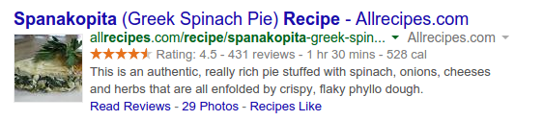
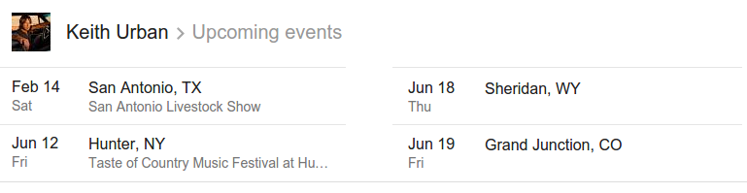
Structured Data Markup
A standard way to annotate your content so machines can understand it
Google (and other search engines) can
use that data to index your content better
present it more prominently in search results
Provide answers from the Knowledge Graph

Slide 32
Structured Data Markup (2)
Three alternative formats:
Microdata and RDFa
Define new HTML attributes
More info: http://schema.org/docs/gs.html#microdata_how
JSON-LD
Newest and simplest markup format
Embed a block of JSON data inside a script tag
Specification: http://www.w3.org/TR/json-ld/
Examples: http://json-ld.org/playground/

Slide 33
Semantic Web
http://academy.telerik.com

Slide 34




Free Trainings @ Telerik Academy
"Web Design with HTML5, CSS3 and JavaScript" course @ Telerik Academy
html5course.telerik.com
Telerik Software Academy
academy.telerik.com
Telerik Academy @ Facebook
facebook.com/TelerikAcademy
Telerik Software Academy Forums
forums.academy.telerik.com

